Slide 1



SQLucid: Grounding Natural Language Database Queries with Interactive Explanations
Yuan Tian Purdue University
Jonathan K. Kummerfeld The University of Sydney
Toby Jia-Jun Li University of Notre Dame
Tianyi Zhang Purdue University

Slide 2




There is a Growing Demand for Querying Databases
SQL Query
User
Databases
Query result

Slide 3


NL Interfaces for Databases
Text-to-SQL
Model
Non-expert
Databases
Query result

Slide 4


NL Interfaces may misinterpret user intents
Best models have error rates of at least 10% on Spider [Yu et al., 2018] and 27% on BIRD [Li et al., 2023]
Cause severe consequences in high-stakes domains
Text-to-SQL
Model
Databases
Users don’t trust the model!
Wrong result

Slide 5



Interactive SQL Generation
Explain system decision to users
Increase user trust
Help users detect errors
Incorporate user feedback
Remove ambiguity
Allow user to fix errors
MISP [Yao et al., 2019] Multiple choice questions.
DIY [Narechania et al., 2021] Small database, NL, mappings, drop-downs.
SQLVis [Miedema et al., 2021] Visualize SQL as graph.

Slide 6
Interactive approaches are not effective
A recent study [1] shows these approaches don’t work well.
Hard to understand the generated query and provide feedback.
 | Accuracy | SD
Manual Edit SQL | 0.55 | 0.48
MISP [Yao et al., 2019] | 0.53 | 0.51
DIY [Narechania et al., 2021] | 0.56 | 0.51
SQLVis [Miedema et al., 2021] | 0.60 | 0.50
[1] Ning, Z., Zhang, Z., Sun, T., Tian, Y., Zhang, T., & Li, T. J.-J. An empirical study of model errors and user error discovery and repair strategies in natural language database queries (IUI’23)

Slide 7
Limitations of Existing Interactive Approaches
MISP [Yao et al., 2019]
DIY [Narechania et al., 2021]
SQLVis [Miedema et al., 2021]
Limited Explanations
No explanations
Small database is inconsistent
Graph is overwhelming
Constrained Feedbacks
Passively answer questions
Only simple edits
No feedback

Slide 8

Grounding Theory in Communication
Mutual Understanding
Common ground
Shared knowledge
Ensure messages interpreted correctly
Human
Human
Common Ground
Grounding in Communication [Clark et al. 1991]

Slide 9
SQLucid: Grounding Natural Language Database Queries with Interactive Explanations
Three Key features
Editable
Step-by-step Explanation
Visual Correspondence
Intermediate Query Results
1
2
3
inspired by Grounding Theory

Slide 10


Interactive Explanation as Common Ground
What's the lowest flight price?
In table flight
Sort records based on price, get the minimum price
Return the price
Agent
Human
Common Ground
Human and the agent collaboratively refine the query

Slide 11
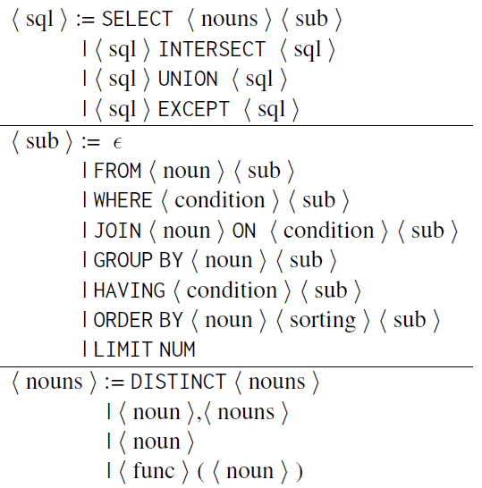
Step-by-step Explanation Generation Rules
SQL Element | Translation
SELECT | Retrun
FROM | In table
JOIN | And table
* | all records
T.col | {col} of {T}
= | is
!= | is not
> | greater than
LIKE | in form of
… | …

Slide 12

Visual Correspondence via Highlighting
price
300
200
500
In table flight
Sort records based on price, get the minimum price
Return the price
Agent
Human
Common Ground

Slide 13
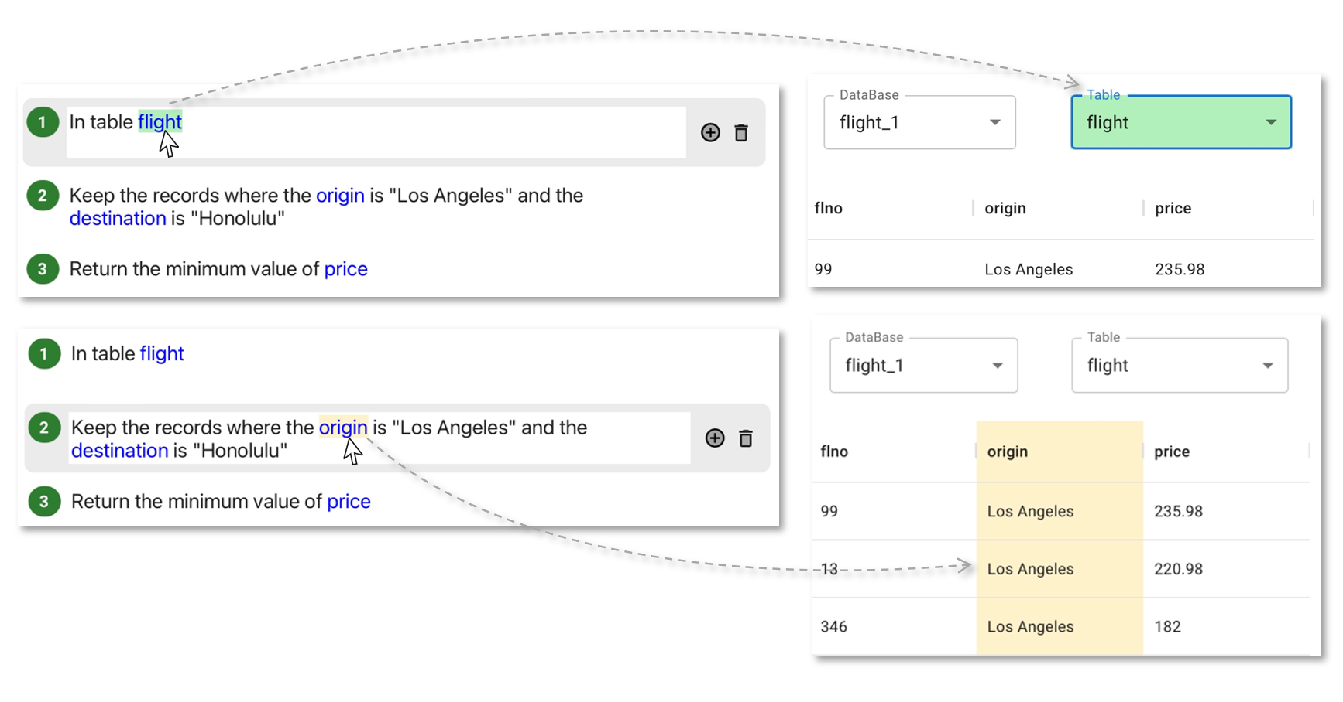
Visual Correspondence via Highlighting (UI)

Slide 14

Intermediate Query Results
ID | price
2 | 200
1 | 300
3 | 500
In table flight
Sort records based on price, get the minimum price
Return the price
Agent
Human
Common Ground

Slide 15




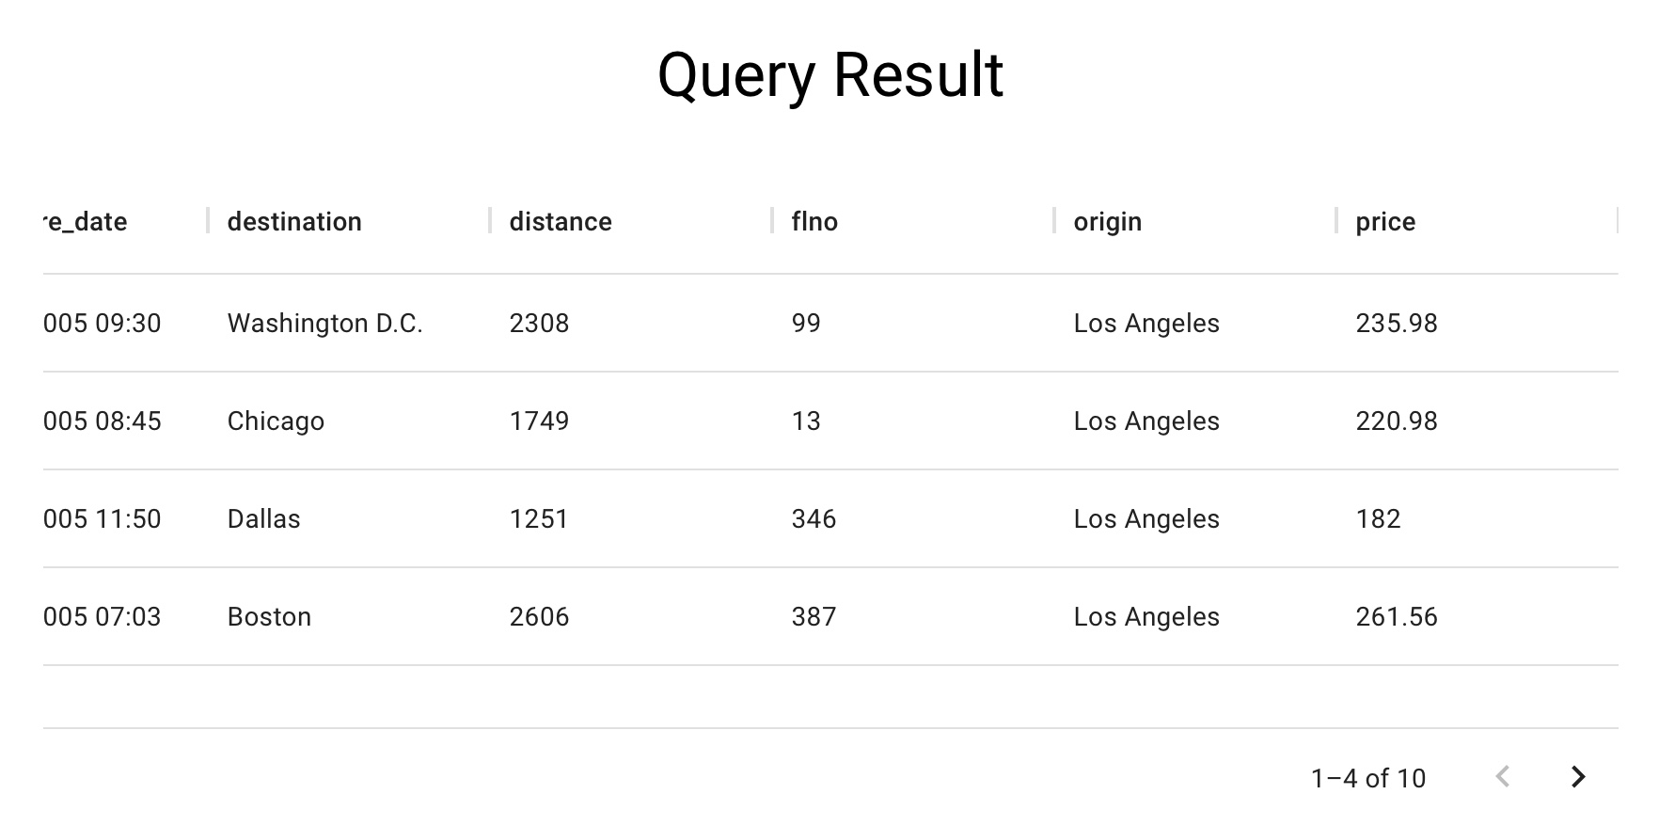
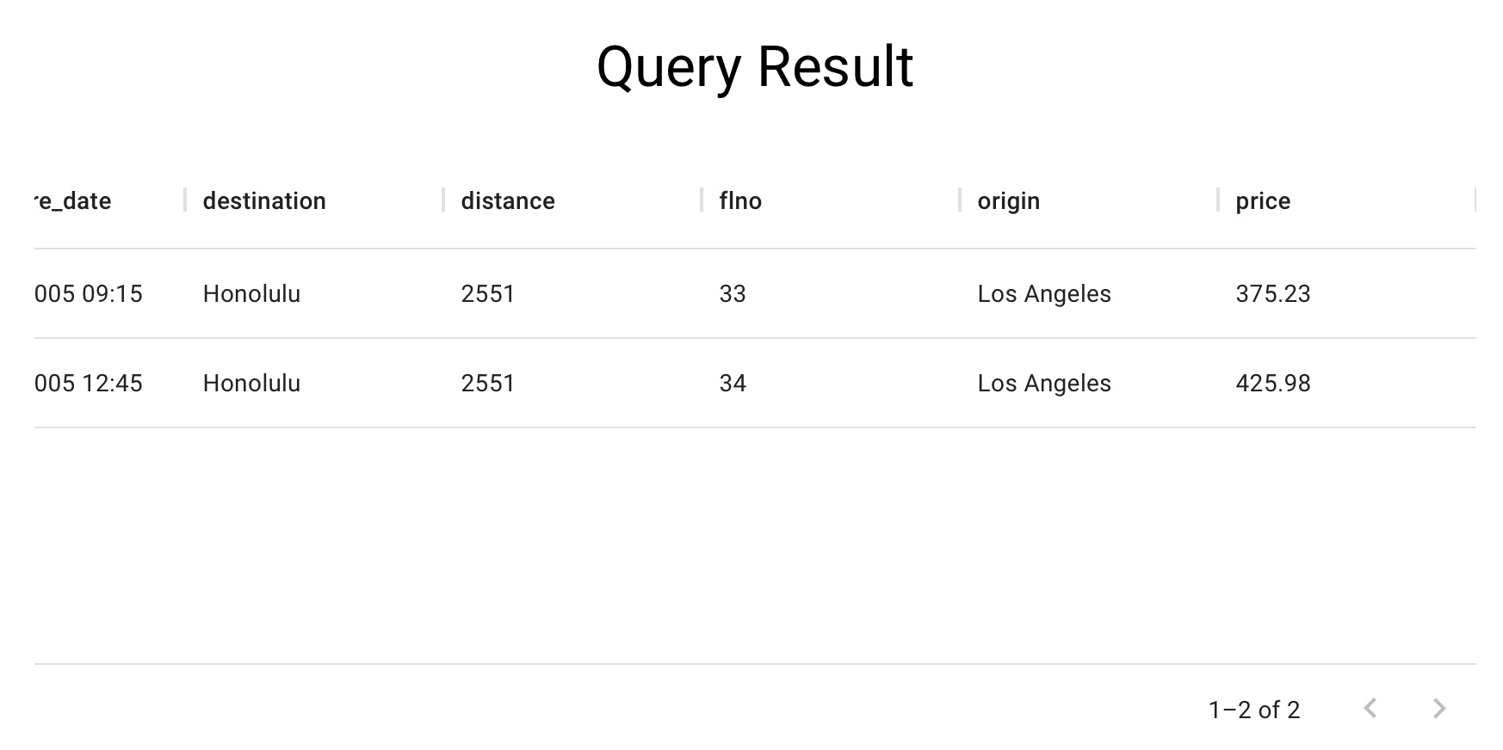

Intermediate Query Results (UI)
SELECT * FROM flight
WHERE origin = “Los Angeles”
SELECT MIN(price) FROM flight
WHERE origin = “Los Angeles”
1-4 of 100
SELECT * FROM flight

Slide 16
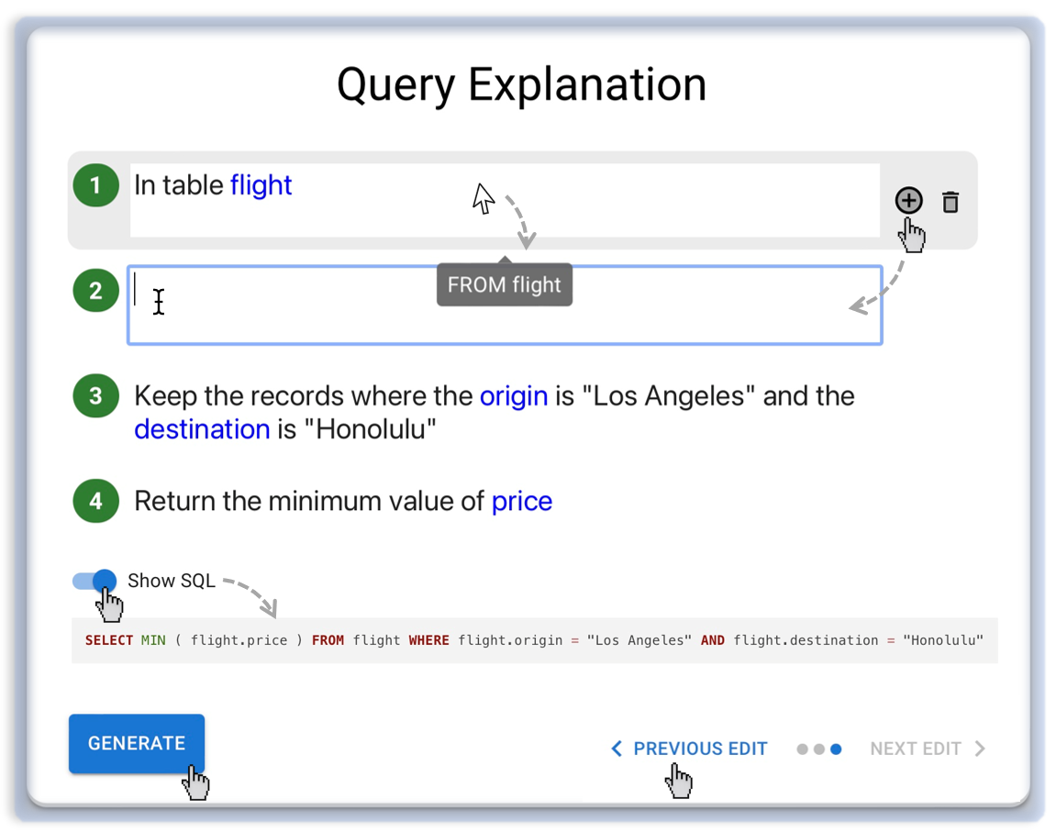
Edit Explanation to Give Feedback (UI)
Freely edit the explanation to give feedback.
Check edit history and undo/redo some edits.

Slide 17
Text-to-clause model
Spider
Explanation generator
Modify decoding rules of a transformer-based text-to-SQL model [Rubin et al., 2021]
Finetuned on synthetic data produced by grammar-based explanation generator
90.6% exact match accuracy
Get lowest price
Synthetic data
SELECT MIN(price)
Paraphrase
Fine-tune
Transformer

Slide 18
Evaluation
User Study 1: Compare with other interactive approaches
MISP [Yao et al., 2019] → Conversational, multiple-choice question
DIY [Narechania et al., 2021] → Sampled Database, Drop-down menu
User Study 2: Ablation study to study the effectiveness of key features
Text Explanation
Text Explanation + Visual correspondence
Text Explanation + Intermediate results

Slide 19
User Study 1
1
15 never heard about SQL before
(End-user)
SQL generation tasks
10 minutes
MISP
[Yao et al., 2019]
10 knew SQL basics
(Novice)
2
DIY
[Narechania et al., 2021]
5 could write SQL fluent
(Expert)
Baseline
30 Participants
Tasks

Slide 20

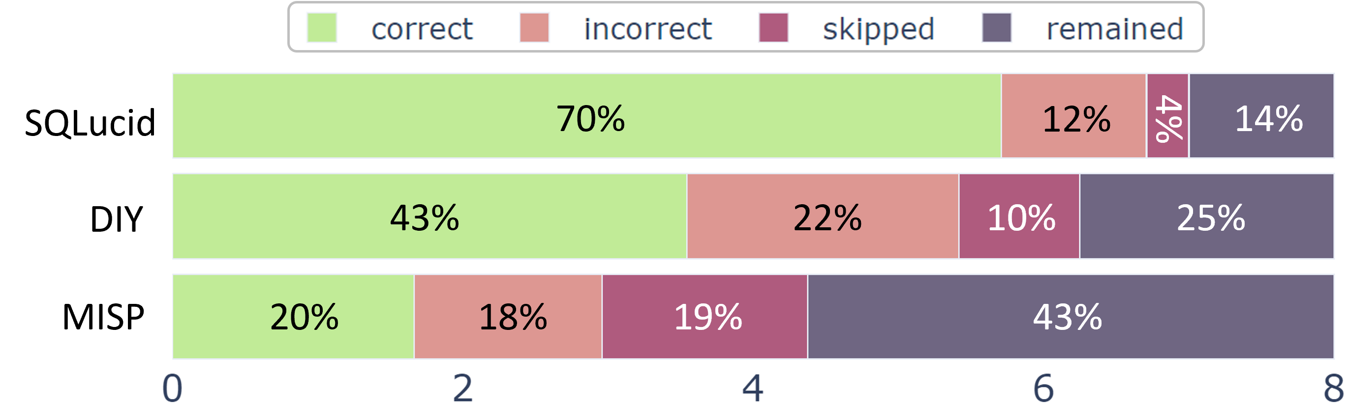
User Study 1 (Key Results)
SQLucid outperforms other tools in SQL generation performances

Slide 21
User Study 1 (Key Results)
SQLucid consistently improves performance across different user expertise
 | End-user | Novice | Expert
MISP [Yao et al., 2019] | 1.6 | 1.4 | 2.2
DIY [Narechania et al., 2021] | 3.3 | 3.5 | 3.8
SQLucid | 5.4 | 5.7 | 5.9

Slide 22
User Study 1 (Key Results)
SQLucid consistently improves performance across different task difficulty
 | Easy | Medium | Hard | Extra Hard
MISP [Yao et al., 2019] | 0.81 | 0.49 | 0.21 | 0.12
DIY [Narechania et al., 2021] | 1.40 | 1.19 | 0.54 | 0.35
SQLucid | 1.62 | 1.48 | 1.39 | 1.14

Slide 23
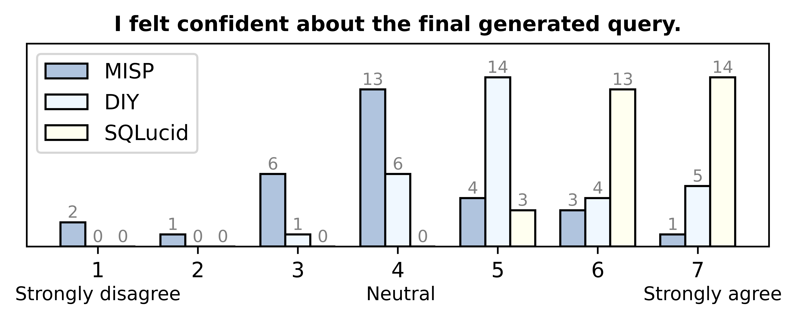
User Study 1 (Key Results)
SQLucid significantly improves user confidence

Slide 24
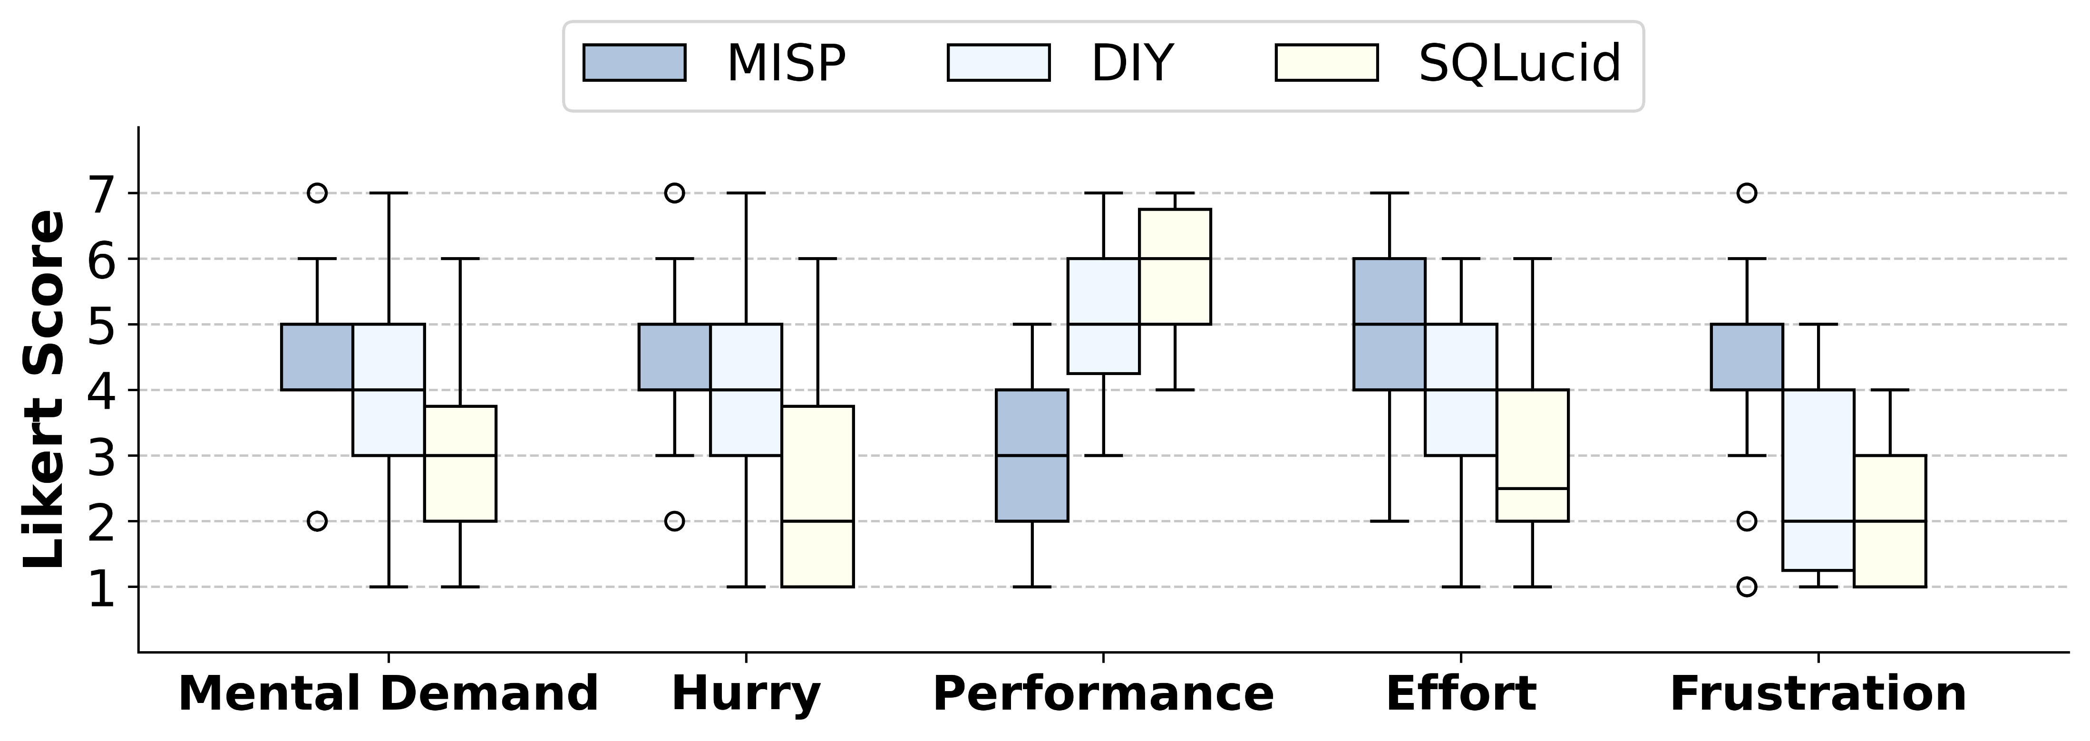
User Study 1 (Key Results)
SQLucid significantly reduces user cognitive load

Slide 25
User Study 2
1
- intermediate result
- visual correspondence
4 never heard about SQL before
(End-user)
SQL generation tasks
10 minutes
2
- intermediate result
+ visual correspondence
2 knew SQL basics
(Novice)
3
+ intermediate result
- visual correspondence
2 could write SQL fluent
(Expert)
Baseline
8 Participants
Tasks

Slide 26
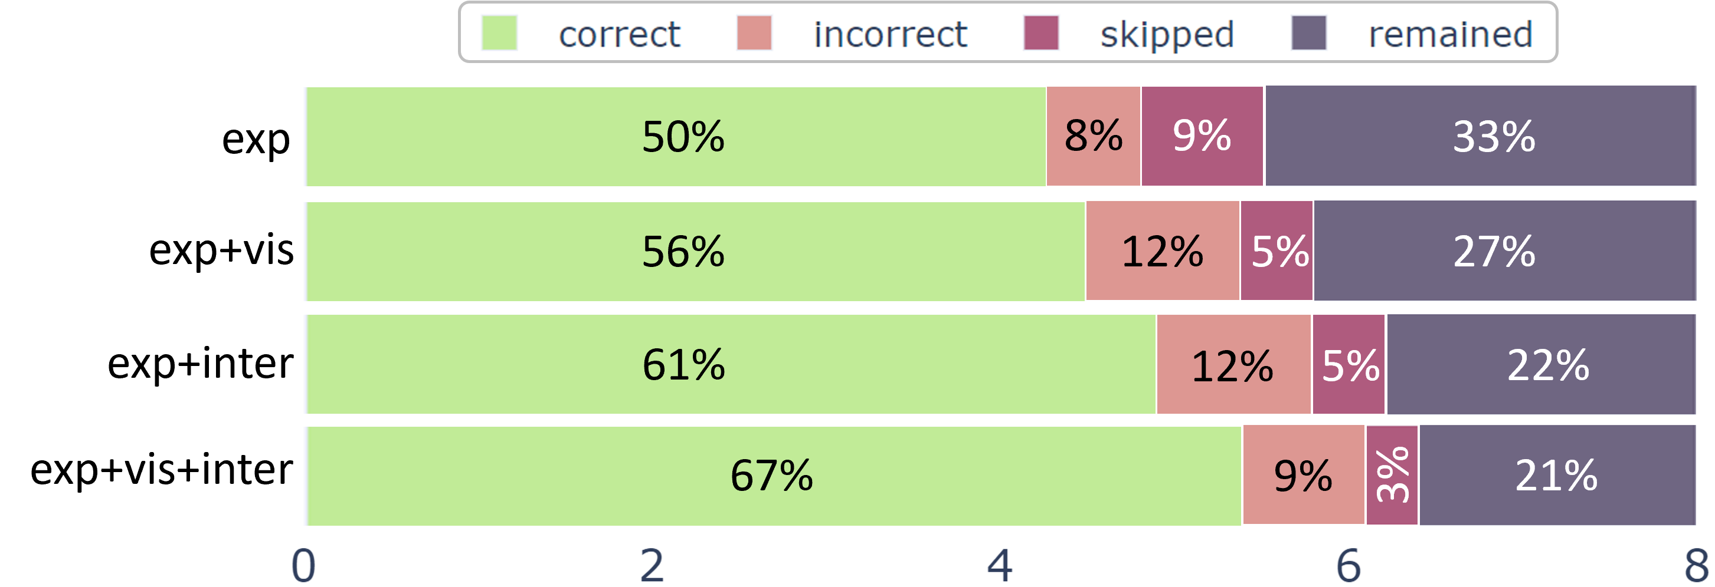
User Study 2 (Key Results)
Both features contribute to performance improvement

Slide 27
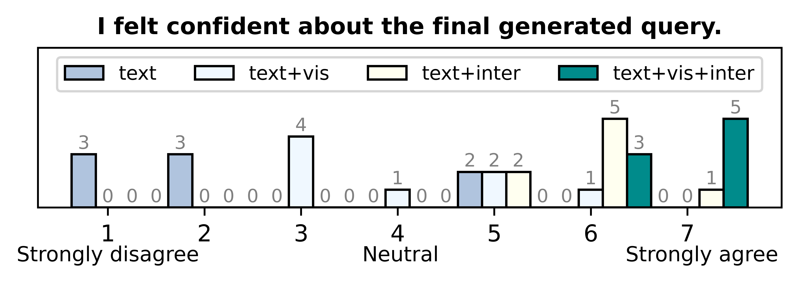
User Study 2 (Key Results)
Both features contribute to improving user confidence

Slide 28
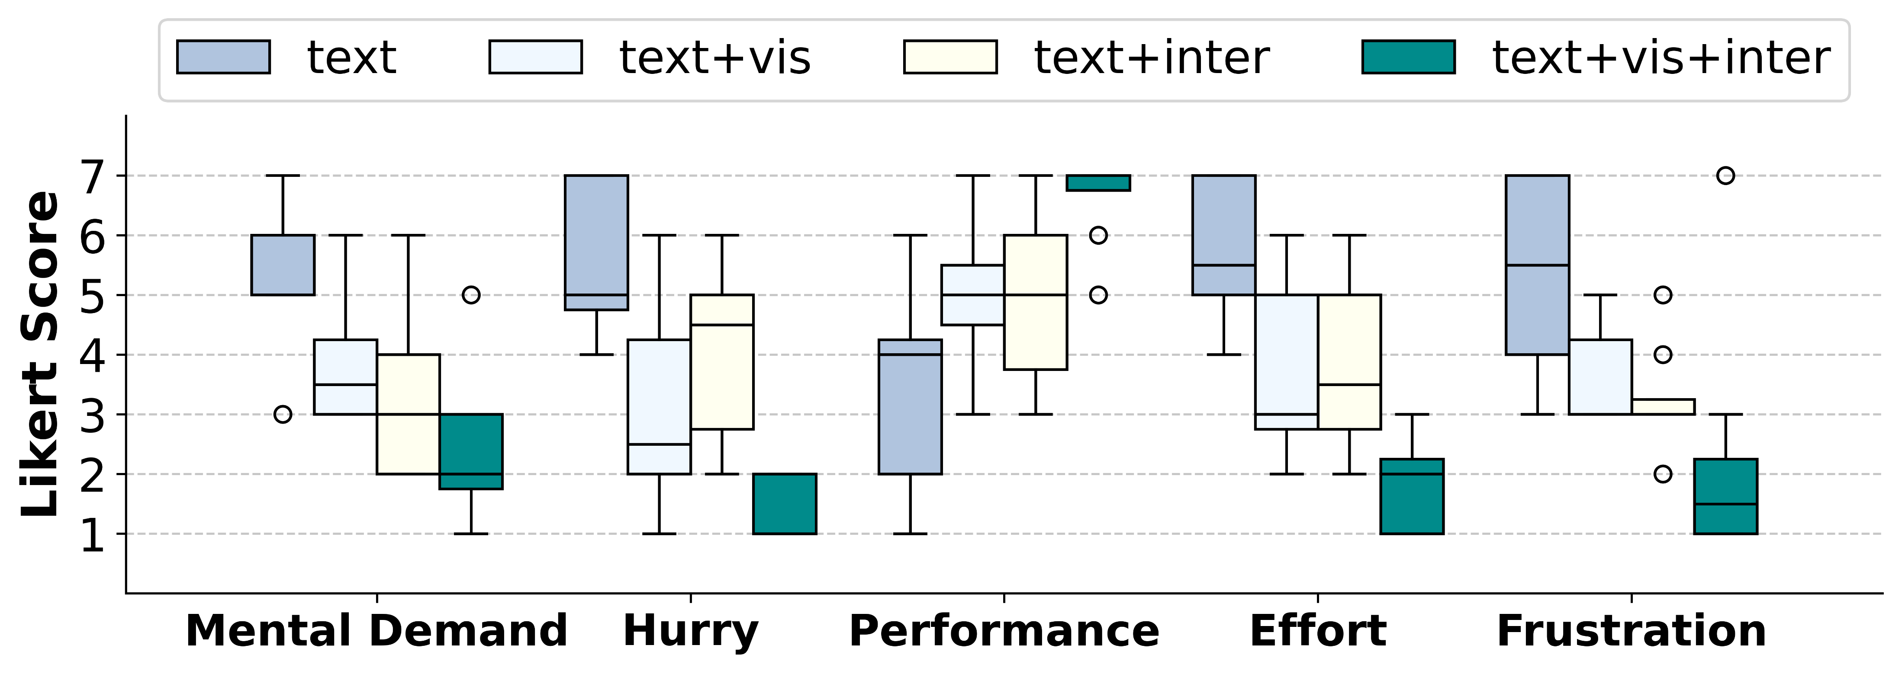
User Study 2 (Key Results)
Both features contribute to reducing user cognitive load

Slide 29
Design Implications
Establish common ground for mutual understanding.
Implement free-form feedback to improve performance.
Use task decomposition to reduce task complexity and isolate errors.
Use visual correspondence for navigation in data-intensive applications.

Slide 30
Conclusion
We introduce SQLucid, an interactive database query system.
SQLucid helps users understand generated query and freely fix errors.
SQLucid significantly improves natural language query performance, with less user cognitive load and higher confidence.

Slide 31

Thank you!
Q & A
https://github.com/magic-YuanTian/SQLucid
Paper, Code, Demo

